Slide 1
JavaScript III
Web Development

Slide 2
Overview
Using Array
JavaScript Built-in Objects
Define your own object

Slide 3

Using Array
Declare an Array
var marks=[];
or
var marks=new Array(); // new Array(4);
Declare and initialize an Array
var marks=[45,60,90,100];
or
var marks=new Array(45,60,90,100);
We use this
We use this

Slide 4
JavaScript: Array
Suppose I wanted to model a group of friends:
var friend1="Daniel";
var friend2="John";
var friend3="Joanne";
var friend4="Liz";
The list for friend may grow… what is a better way to group them?

Slide 5
JavaScript:Array
var friends=["Daniel","John","Joanne","Liz"];
friends
Daniel | John | Joanne | Liz
Friends[0]
[1]
[2]
[3]
Array are indexed starting at 0. Every element has a corresponding number(index)

Slide 6
JavaScript Array : Retrieving
var marks=[80,85,75,65];
Retrieve Data From Array
var englishMark=marks[0];
var friends=["Daniel","John","Joanne","Liz"];
var bestFriend=friends[2];

Slide 7
JavaScript Array : update
Assign value/update an array item
marks[0]=80;
marks[1]=90;
friends[0]="David";

Slide 8
JavaScript Array : Add new data
var friends=["David","John","Joanne","Liz"];
David | John | Joanne | Liz
0
1
2
3
Friends[4]="Nicole";
David | John | Joanne | Liz | Nicole
0
1
2
3
4

Slide 9
JavaScript Array : Create/Initialize
Create a new friends array with no friends
var friends = [];
Or
var friends = new Array() //uncommon
We use this

Slide 10
JavaScript Array : Size
var marks=[80,85,75,65];
marks.length tells the size of the array
document.write("number of marks "+marks.length);
for (var i=0; i<marks.length; i++){
console.log(marks[i]);
}

Slide 11
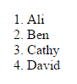
JavaScript Array Example (qn 1)
<script>
var students=["Ali","Ben","Cathy","David"];
document.write("<ol>");
for (var i=0; i<students.length; i++){
document.write("<li>"+students[i]+"</li>");
}
document.write("</ol");
</script>

Slide 12
JavaScript Array Methods
Use push to add to the end of the array
var colors = ["red", "orange", "yellow"];
colors.push("green");
Elements in colors become:
["red", "orange", "yellow", "green"]

Slide 13
JavaScript Array Methods
Use pop to remove the last element in an array
var colors = ["red", "orange", "yellow", "green"];
colors.pop();
Elements in colors become:
["red", "orange", "yellow"]

Slide 14
JavaScript Array Methods
Use unshift to add to the front of the array
var colors = ["red", "orange", "yellow"];
colors.unshift("green");
Elements in colors become:
["green", "red", "orange", "yellow"]

Slide 15
JavaScript Array Methods
Use shift to remove the first element in an array
var colors = ["red", "orange", "yellow"];
colors.shift();
Elements in colors become:
["orange", "yellow"]

Slide 16
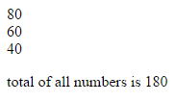
JavaScript Array Example (qn 2, 3)
<script>
var numbers=[];
numbers.push(80);
numbers.push(60);
numbers.push(40);
var total=0;
for (var i=0; i<numbers.length; i++){
document.write(numbers[i]+"<br>");
total=total+numbers[i];
}
document.write("<p>total of all numbers is "+
total+"</p>");
</script>

Slide 17
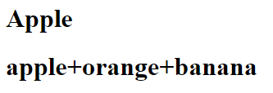
JavaScript Array Example
Joining the array elements
<script>
var chars=["A","p","p","l","e"];
var fruits=["apple","orange","banana"];
document.write("<h1>"+chars.join("")+"</h1>");
document.write("<h1>"+fruits.join("+")+"</h1>");
</script>

Slide 18
JavaScript Objects
JavaScript comes with a number of built-in objects for the convenience of programmers, such as
Array
Date
Math
String
Provide efficient way of store & manipulate data
Store and work with dates and time
Access to useful math functions or operations
Provide efficient way of store & manipulate data

Slide 19
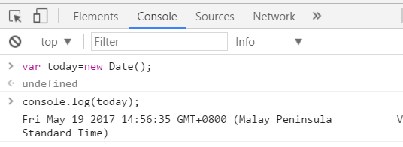
JavaScript Date Object
Example:
var today=new Date();
console.log(today);

Slide 20
Define JavaScript Object: Create/Initialize
var myCar = new Object();
Or
var myCar = {};
We use this

Slide 21
JavaScript Object
Assign properties to the object
myCar.make = "Ford";
myCar.model = "Mustang";
myCar.year = 1969;
Now myCar has the attribute make, model and year with the values
console.log(myCar);
Object {make: "Ford", model: "Mustang", year: 1969}

Slide 22
JavaScript Object
Properties of object can also be accessed using the bracket notation:
myCar["make"] = "Ford";
myCar["model"] = "Mustang";
myCar["year"] = 1969;

Slide 23
Retrieve object properties (qn 4b)
Example:
for (var p in myCar) { // for each of the properties in myCar
document.write(myCar[p]);
}

Slide 24
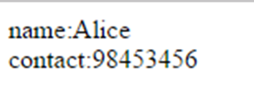
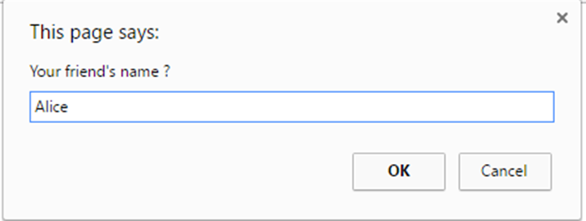
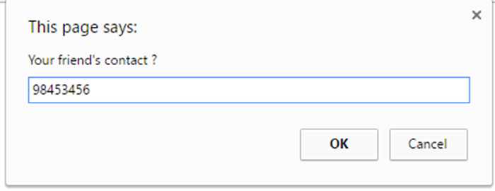
JavaScript Object
<script>
var friend={};
var input_name=prompt("Your friend's name ?");
var input_contact=prompt("Your friend's contact ?");
friend.name=input_name;
friend.contact=input_contact;
for (var info in friend) { document.write(info+":"+friend[info]+"<br>");
}
</script>

Slide 25
Declare and initialize an object (qn4a)
var myCar = {"make":"Ford", "model":"Mustang", "year":1969};

Slide 26
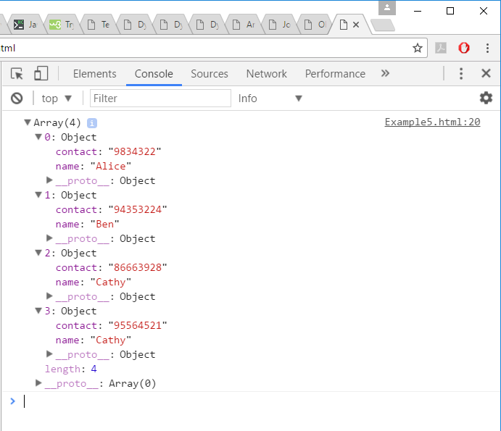
Array of Objects
<script>
var friend1={"name":"Alice","contact":"9834322"};
var friend2={"name":"Ben","contact":"94353224"};
var friend3={"name":"Cathy","contact":"86663928"};
var friend4={"name":"Cathy","contact":"95564521"};
var allFriends=[];
allFriends.push(friend1);
allFriends.push(friend2);
allFriends.push(friend3);
allFriends.push(friend4);
console.log(allFriends);
</script>

Slide 27
Declare and initialize an Array of objects
var allMyCars=[
{"make":"Ford", "model":"Mustang", "year": 1969 },
{"make":"Toyota", "model":"Camry", "year": 2014 },
{"make":"Subaru", "model":"XV", "year": 2016 }
];

Slide 28
Use function to define JavaScript Object
function Car(make, model, year, owner) {
this.make = make;
this.model = model;
this.year = year;
this.owner = owner;
}
Create a new car in this way:
var car2 = new Car("Nissan", "300ZX", 1992, "ken");
Constructor Function
Without the constructor function, you have to code
this way:
var car2 = {};
car2.make = "Nissan";
car2.model = "300ZX";
car2.year = 1992;
car2.owner = “ken”;

Slide 29
JavaScript Array vs object (Qn 5)
var names=["David","John","Joanne","Liz"];
David | John | Joanne | Liz
names[0]
[1]
[2]
[3]
Var scores=[80,85,75,65];
80 | 85 | 75 | 65
scores[0]
[1]
[2]
[3]
Var students = [ ]; var student={“name”:”David”, “score”:80}
name:David
Score:80
students[0]
[1]
[2]
[3]

